Slide 1
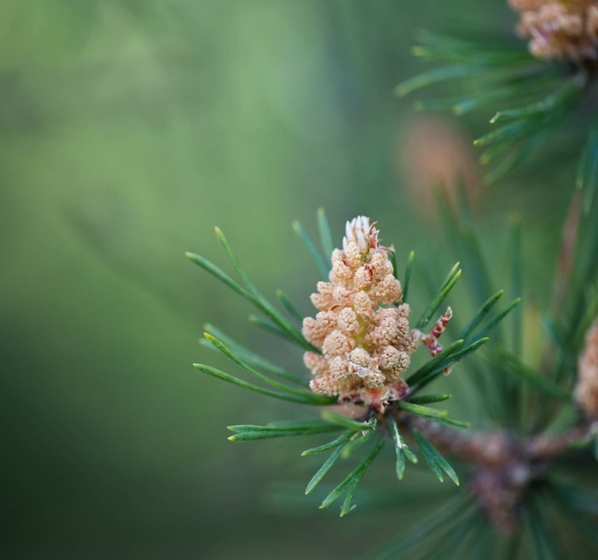
Pesticide recommender system
Ahmad Al Hajj
Christopher Khater
Hashem Khodor
Nour Raffoul
Yehya Charif
Alexander Juvelekian

Slide 2
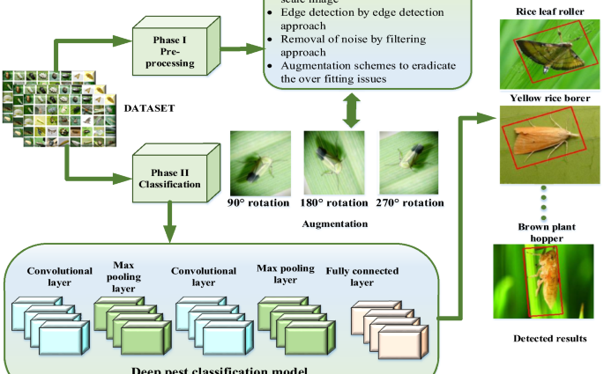
About the project
Problem Statement?
Farmer finds pest on a plant. How should they treat it?
Machine Learning Solution​?
CNN Pest Classifier that feeds a Content-Based Pesticide Recommender

Slide 3
Architecture and data
Image
Pests
Prediction
CNN
Pest/Pesticide Database
Architecture
Convolution Neural Network for Pest Classification
Content-based recommender for Pesticides
Python-based UI
Pesticide
Pool
User Purchase History
Recommendation
Recommender System
Data
Pesticide Dataset
Pest Dataset (Pestopia, shruthisindhura)

Slide 4
Experiments and fine tuning
Experiments
Fine-Tuning
Pest Dataset compression to accommodate for available CPU
Training of CNN using selected elements from Pest Dataset
Low initial performance of CNN, required fine-tuning
Fixed low performance of CNN by fixing learning rate and adjusting batch size
Tried different numbers of filters to fix accuracy while remaining computationally feasible

Slide 5
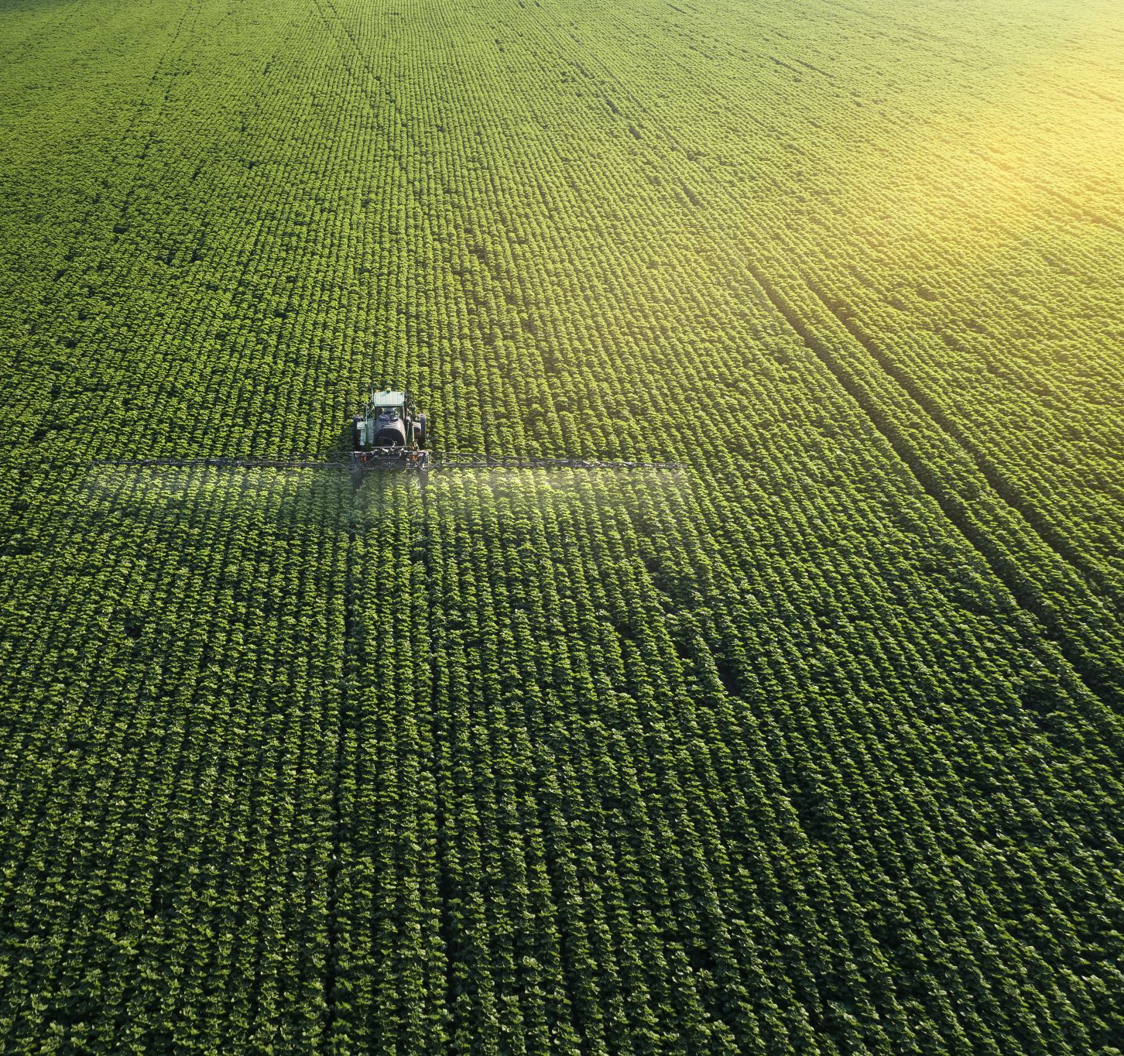
Key Findings and conclusions
Successes and Challenges
Contribution to a very common problem and promising field
Teamwork makes the dream work

Slide 6


Thank you / Q&A

